Slide 1

Live green & Live Happy
Anupam Banerjee
Dante Burch
Gwen Hickey
Robert Gastineau
Shravani Mandalaparty

Slide 2
Background Information& Problem Statement
Background Information
Analyze data on 1,002 individuals engaged in 27 activities of daily life
Interpret activities in context of their carbon footprint as a way to promote environmental sustainability
https://www.mindsumo.com/contests/campus-analytics-challenge-2018
Problem Statement
Recommend environmentally-friendly changes to everyday actions while considering individuals’ quality of life importance for each action.

Slide 3
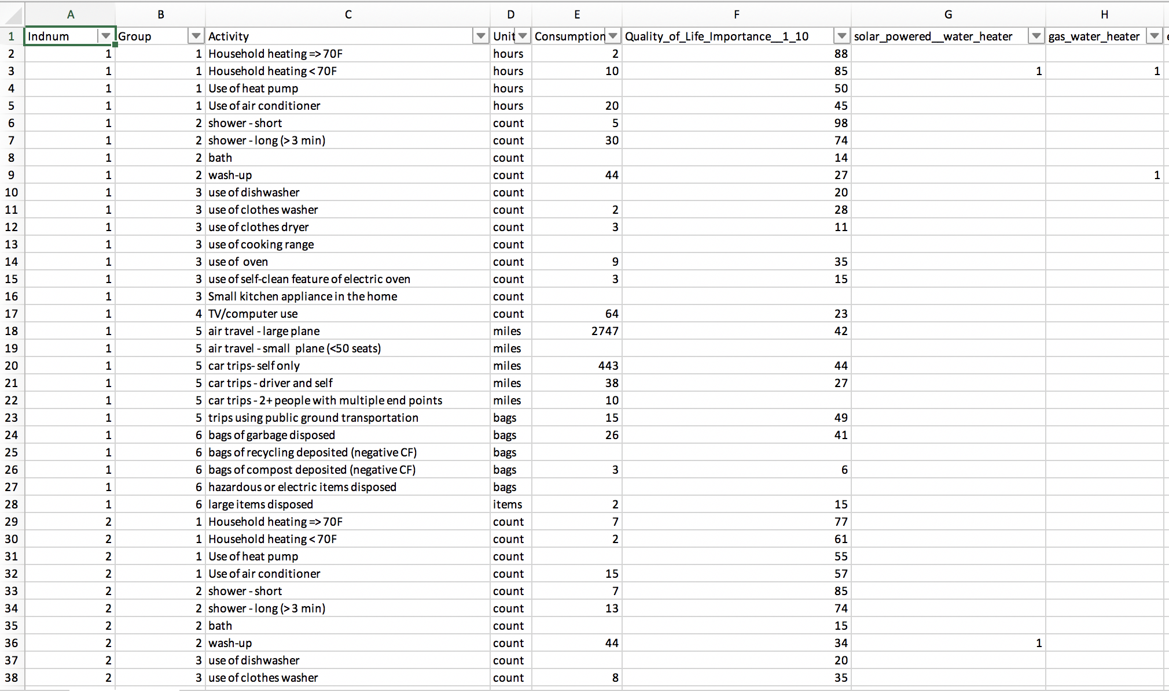
Data Set – Individuals
Data set consists of 1,002 individuals who provided the following information on 27 activities:
Consumption
QoL importance for each (1-100)
Energy Source Usage – Y / N

Slide 4
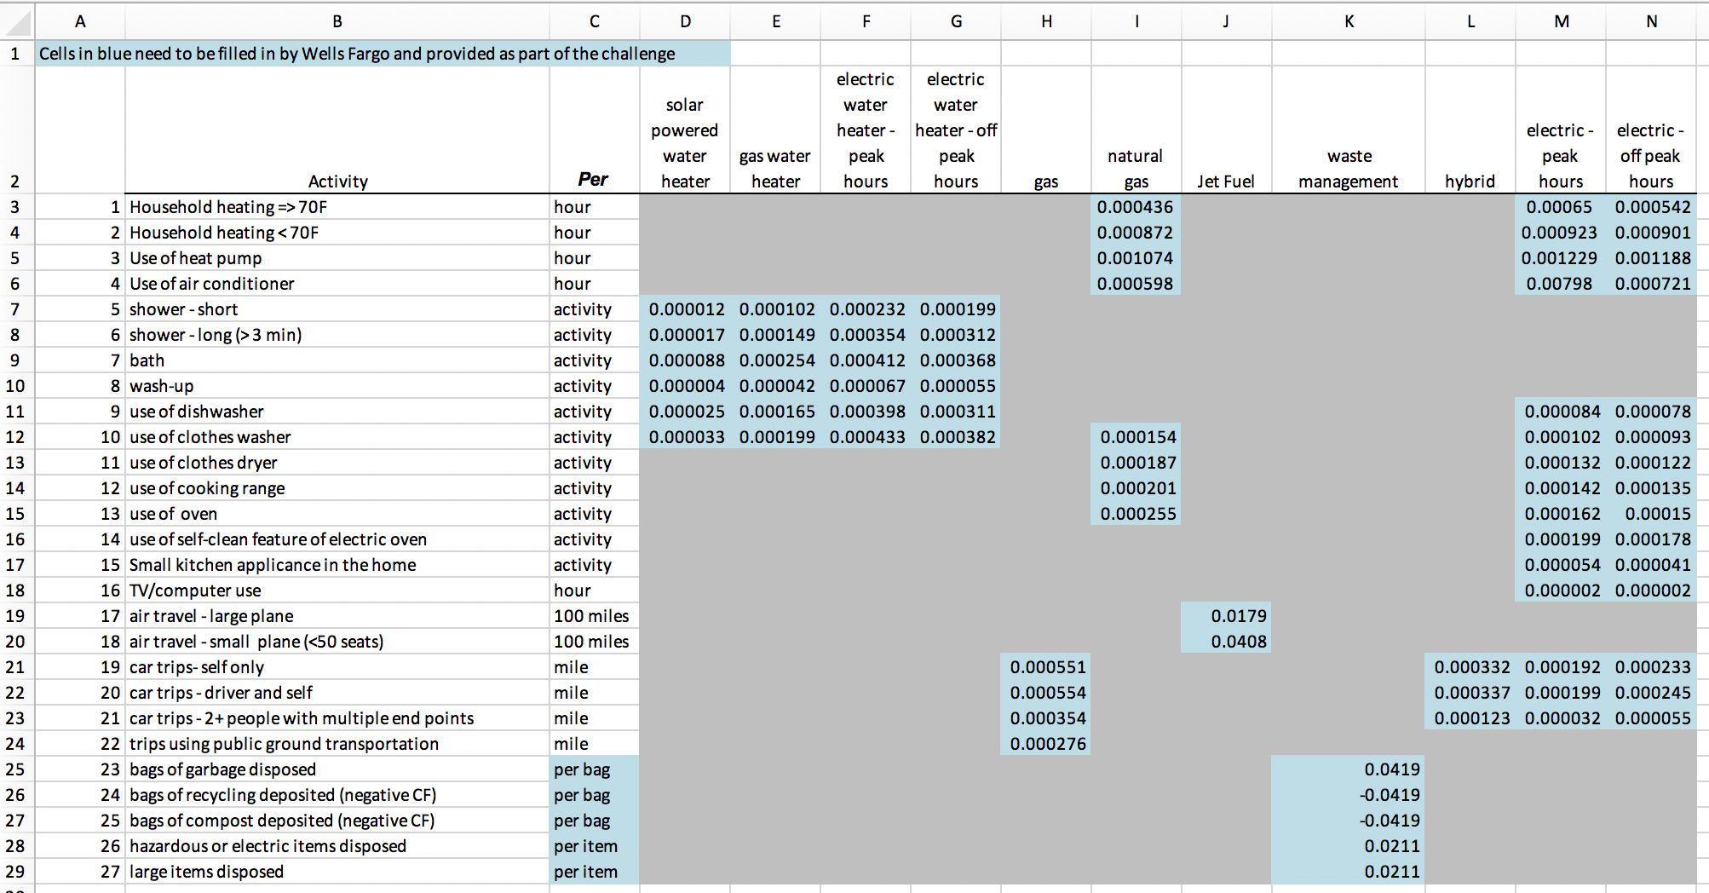
Data Set – Carbon Footprint
”Look-up” table for each of the 27 activities showing:
Carbon Footprint for an activity+ energy source combination

Slide 5
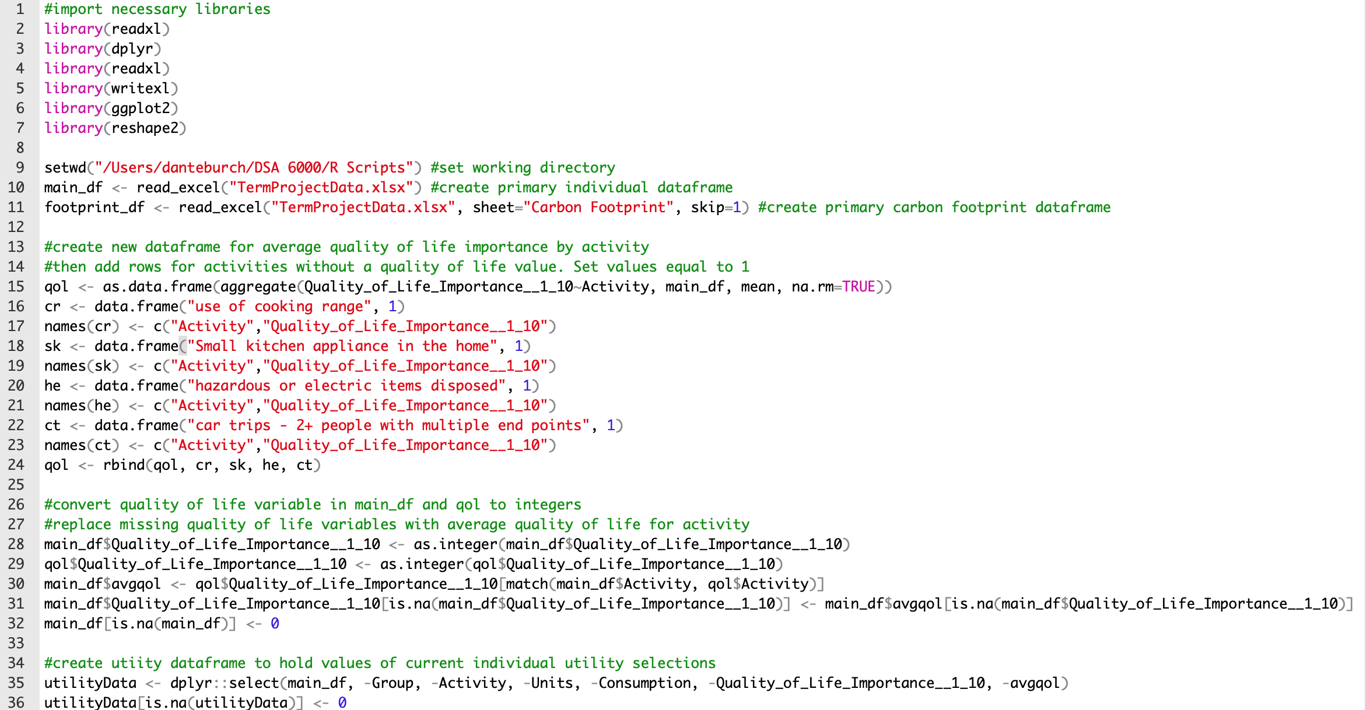
Data Wrangling using R

Slide 6
Data Wrangling Logic & Approach
Assume if a 1 exists for a particular activity, it should exist for all activities that use that energy source
Set energy source usage data to 1 & 0 across all individuals & activities
Calculate Total Carbon Footprint (TCF) for each record
(Consumption * Activity Indicator (y = 1 / n = 0) * CF)
Calculate Average Carbon Footprint (ACF) for each record
TCF / # of energy sources for that activity
For blank values of Consumption, assume the Carbon Footprint is 0
For blank values of quality of life importance, populate it with the mean value – across all individuals – for the given activity

Slide 7
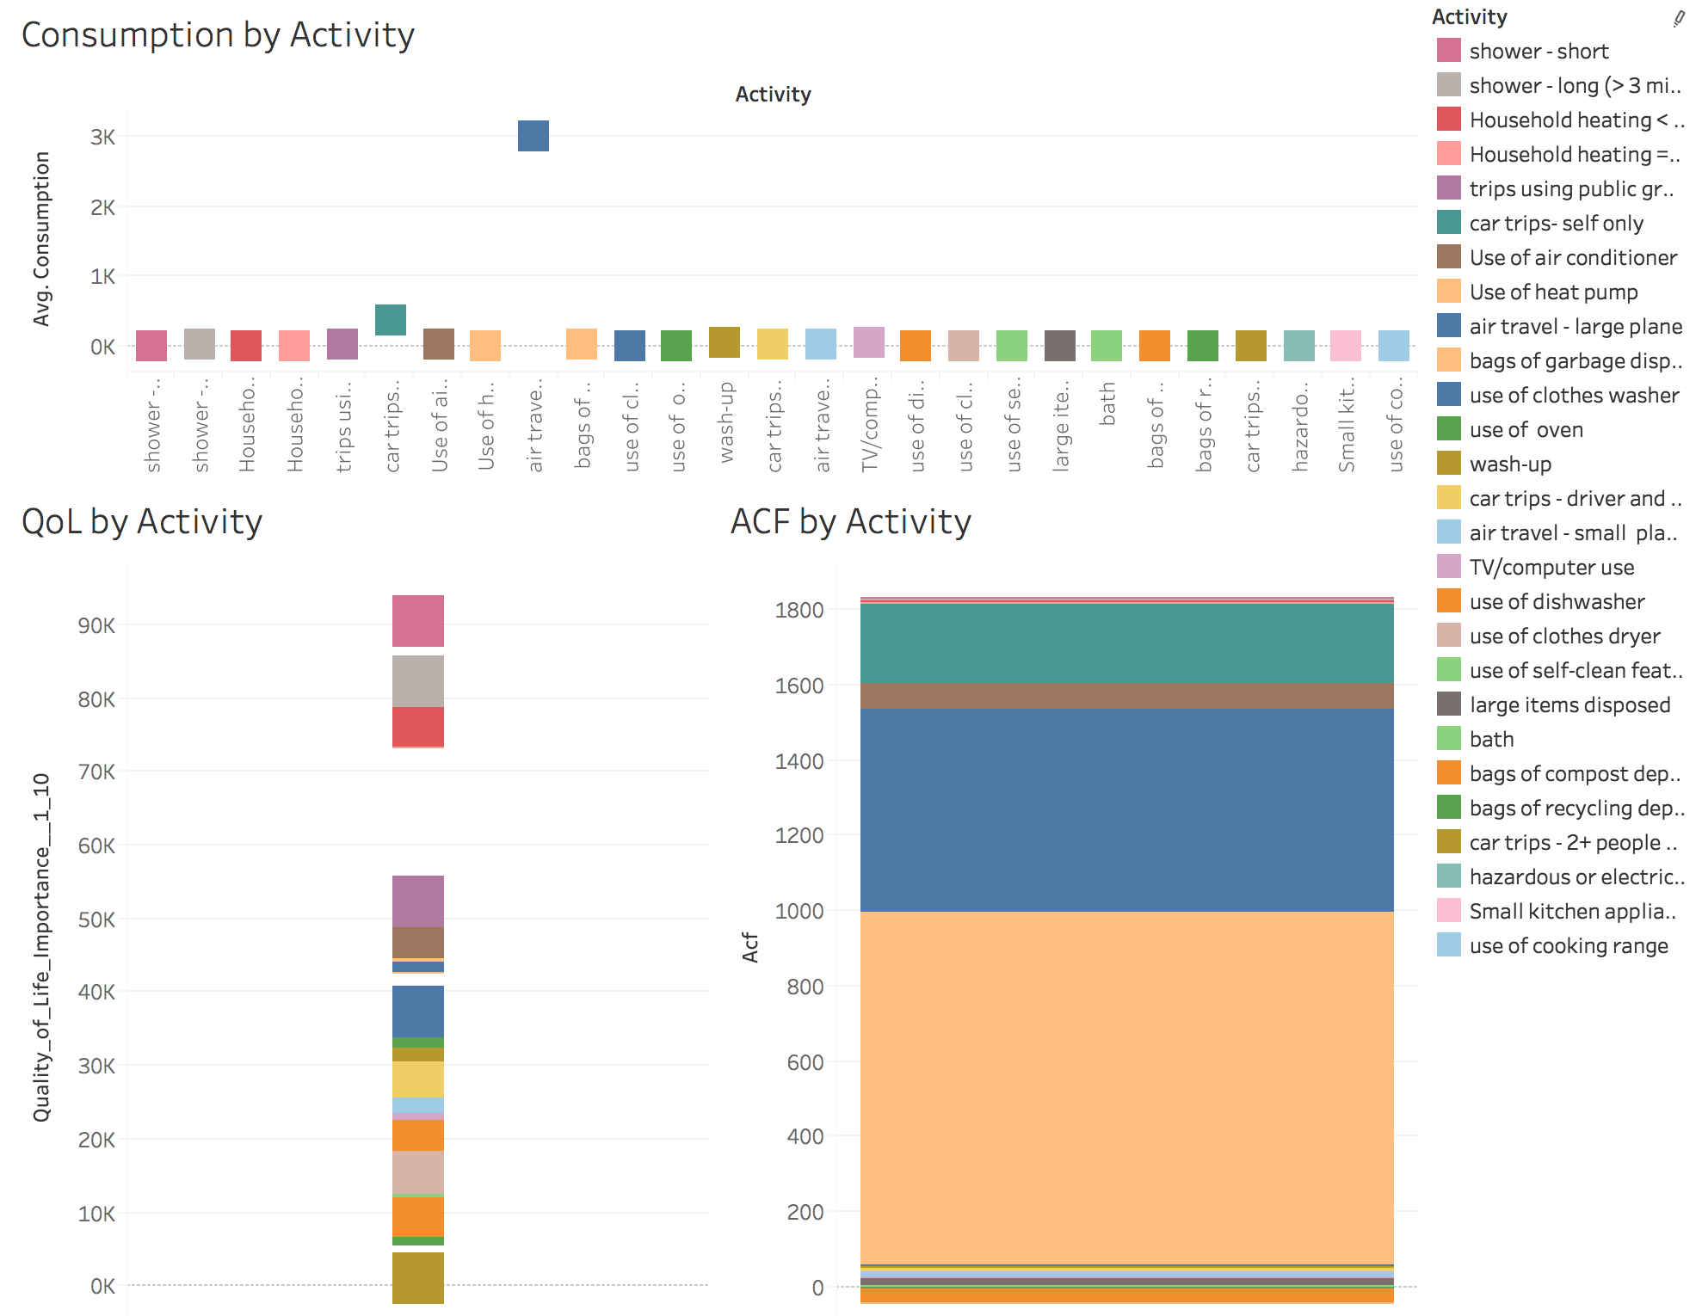
Whole Group before Optimization: QoL, Consumption & ACF by Activity

Slide 8
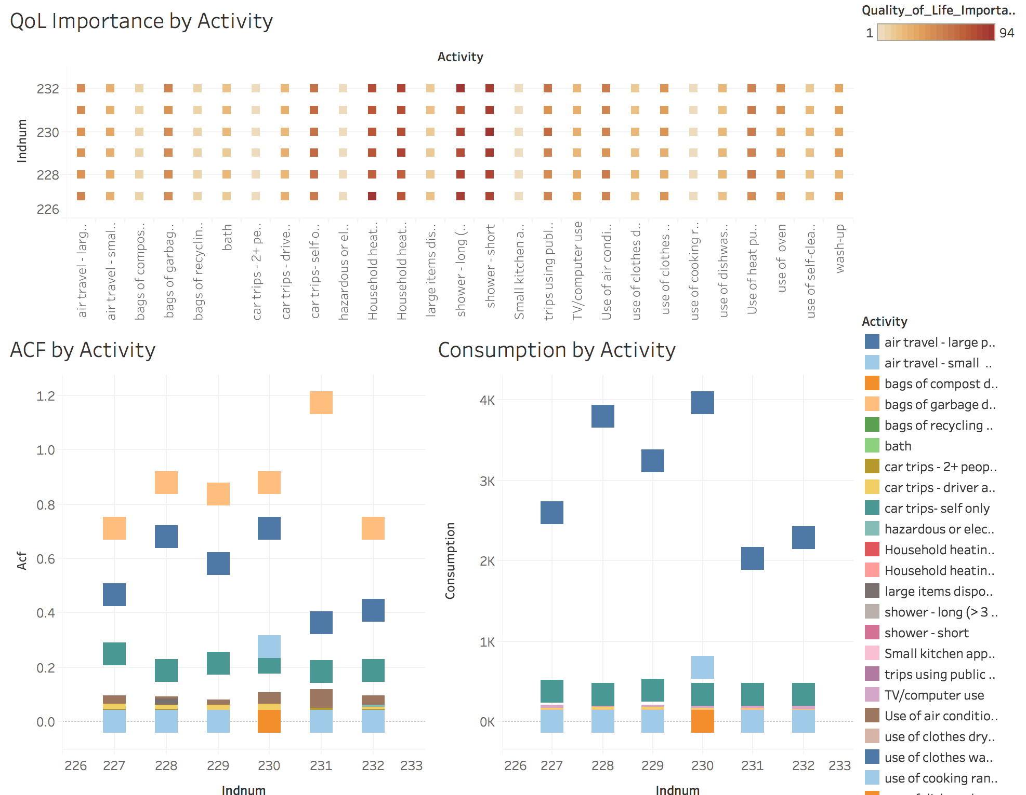
Individuals before Optimization: QoL, Consumption, & ACF by Activity

Slide 9
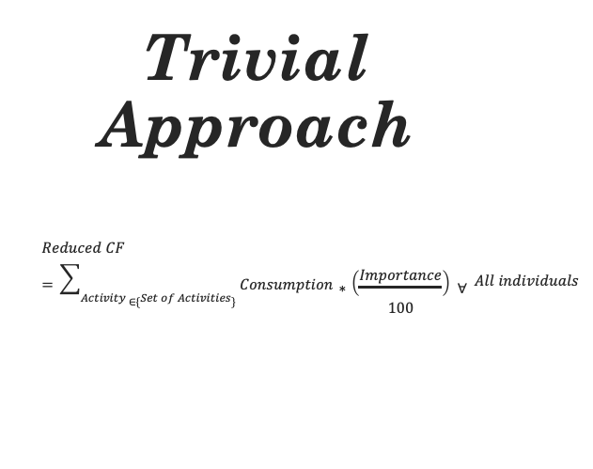
Trivial Approach $$Reduced CF=\sum_{Activity ∈\{Set of Activities\}}{Consumption∗\left(\frac{Importance}{100}\right) ∀} All individuals$$

Slide 10
Constraints & Optimization Logic
For Each Individual:
Maximize:
Quality of Life =Σ(Quality of Life for Activity A)*(Consumption of A)
Minimize:
Carbon Footprint =Σ(Carbon Footprint Rate for Activity A)*(Consumption of A)
Linear Programming Formulation
Maximize :
Σ[(1/a)(Quality of Life for A)-(1/b)(Carbon Footprint Rate for A)]*(Consumption of A)
Decision Variables: Consumption of Each Activity
Constraints: We kept the consumption of different groups of activities constant
Boundaries: We made the boundaries the initial consumption of each activity times a coefficient based on the normalized Quality of Life.

Slide 11
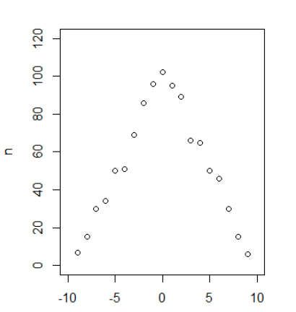
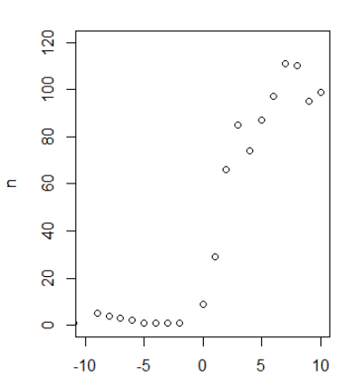
Optimization using R
Activity 1 = Days of Household Temperature>=70 F
Activity 2 = Days of Household Temperature<70 F
Constraint :
Consumption 1 + Consumption 2 = Constant
Lower Bounds:
LB1 = a(Quality of Life 1)*Consumption 1
LB2 = a(Quality of Life 2)*Consumption 2
Upper Bounds:
UB1 = b(Quality of Life 1)*Consumption 1
UB2 = b(Quality of Life 2)*Consumption 2
Initial Distribution of Consumption of Activity 1
Minus
Consumption of Activity 2
Optimized Distribution of Consumption of Activity 1
Minus
Consumption of Activity 2

Slide 12
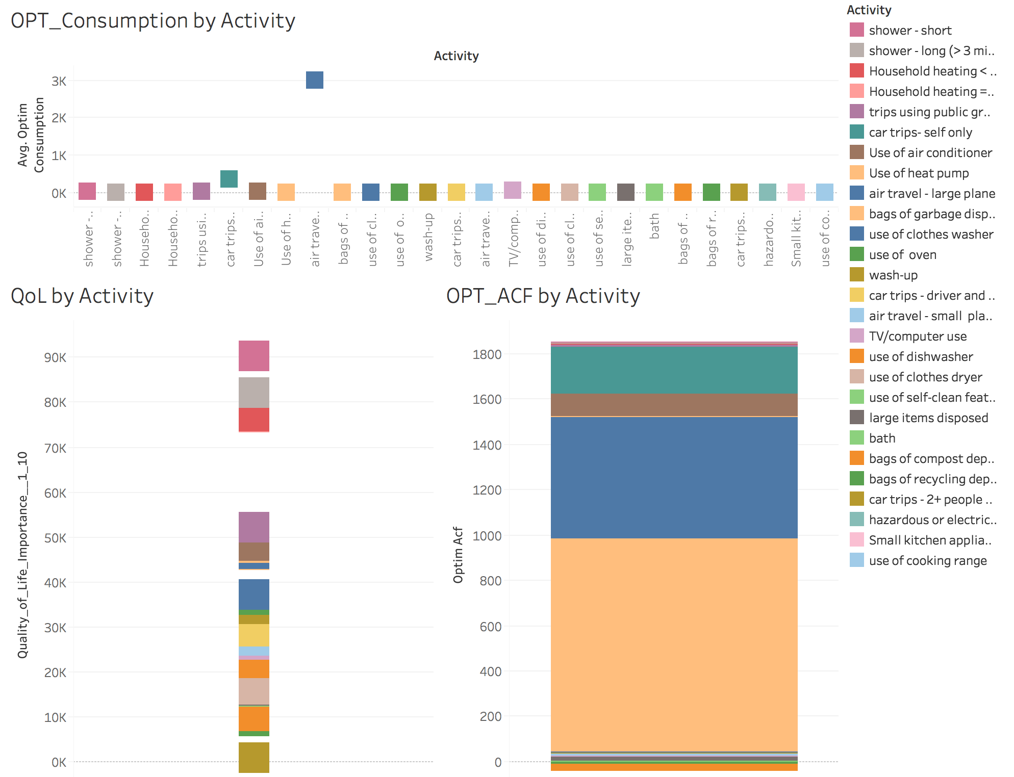
Whole Group after Optimization: QoL, Consumption & ACF by Activity

Slide 13
Individuals after Optimization: QoL, Consumption, & ACF by Activity

Slide 14
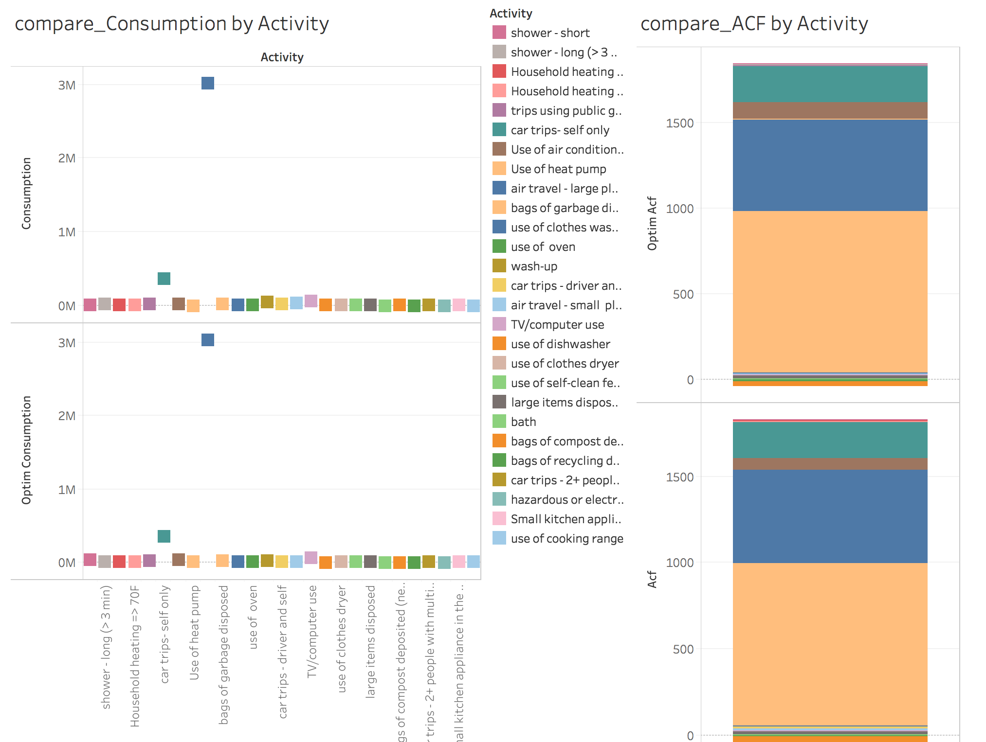
Whole Group Before / After View of Consumption & ACF

Slide 15
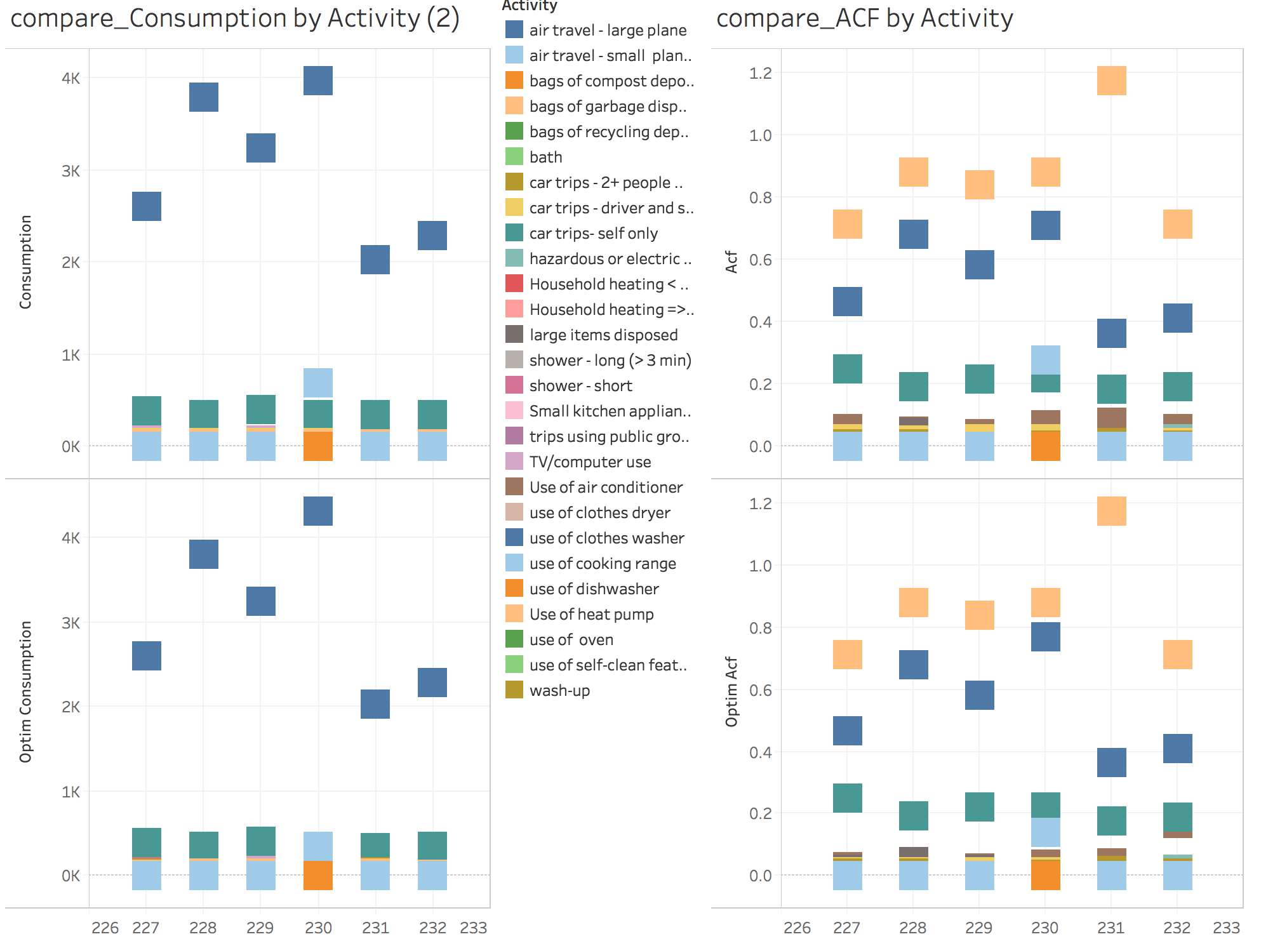
Individuals Before / After View of Consumption & ACF

Slide 16
Results Summary
Optimization focused on minimizing consumption that contributes most to CF, while not reducing the individuals’ Quality of Life Importance
At a high level, while there is some CF and Consumption reduction we can see that QoL importance remains fairly constant

Slide 17
Work in Progress
Preference Analysis using Ranking methods.
Example:
Friedman rank sum test
data: sample_heat
Friedman chi-squared = 242.18, df = 3, p-value < 2.2e-16
Exploring nonlinear machine learning optimization techniques like Nelder and Mead, quasi-Newton method, and conjugate gradients method .

Slide 18
Insight, Limitations & Lessons Learned
Insight:
Problem is very relevant & could easily have real-life application for consumers
Limitations:
Dataset was created with fake data (mentioned in initial challenge statement):
Difficulties finding meaningful patterns (may have been randomly generated)
Some difficulty understanding meaning and implications
Challenging to clean
Lessons Learned:
Optimization focused primarily on consumption reduction; however, replacing less green with more green activities may have provided a bigger CF reduction

Slide 19
Tools & Works Cited
R Studio
Tableau
Campus Analytics Challenge: Live Green and Live Happy, www.mindsumo.com/contests/campus-analytics-challenge-2018. Accessed 30 Nov. 2018.

Slide 20
Questions?

